Slide 1
CS583 Probabilistic Graphical Models
Lecture 22. Learning Networks in pgmpy. Paper overview
Oleksandr Narykov
onarykov@iit.edu

Slide 2
Overview
Parameter Learning
Structure Learning
Practical Example
Data Preparation
Parameter Estimation
Querying
Notebooks:
https://github.com/AlexandrNP/pgmpy_notebook_updated/blob/master/notebooks/10.%20Learning%20Bayesian%20Networks%20from%20Data.ipynb
https://github.com/AlexandrNP/pgmpy_notebook_updated/blob/master/notebooks/11.%20A%20Bayesian%20Network%20to%20model%20the%20influence%20of%20energy%20consumption%20on%20greenhouse%20gases%20in%20Italy.ipynb

Slide 3
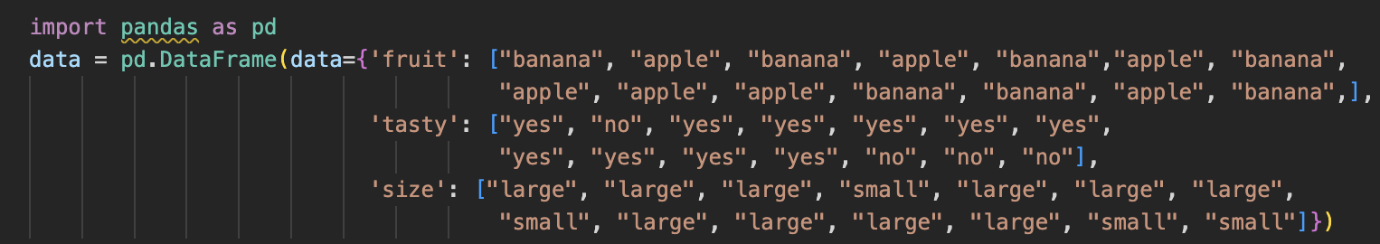
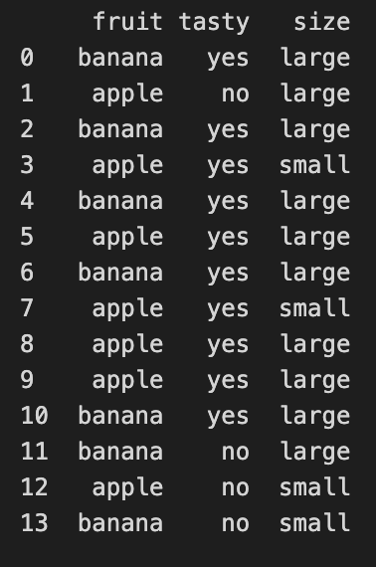
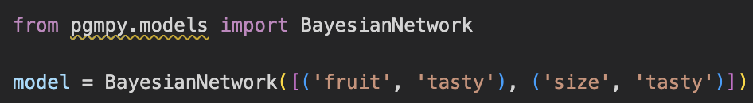
Toy Dataset and Network
Fruit
Size
Tasty

Slide 4

Toy Dataset and Network
Fruit
Size
Tasty

Slide 5
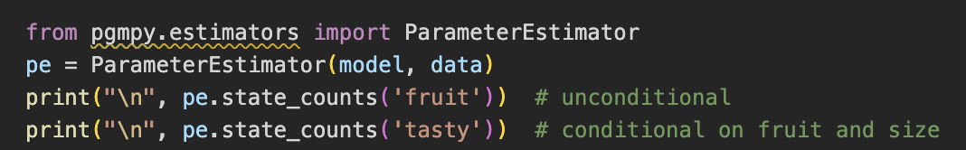
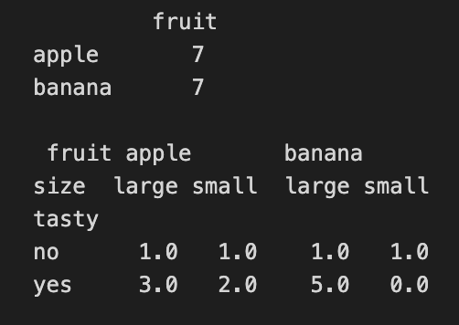
Dataset Statistics
Fruit
Size
Tasty

Slide 6
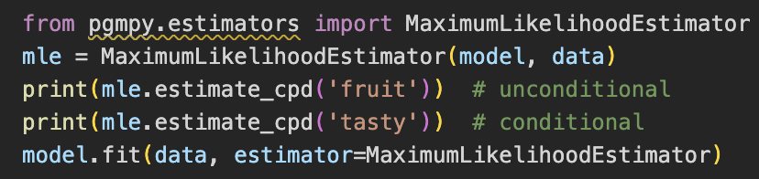
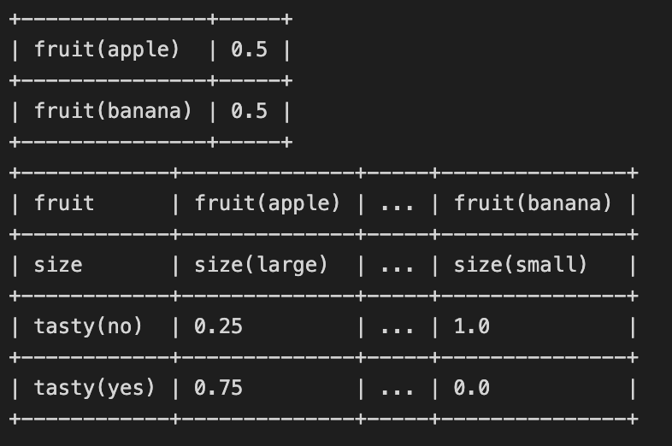

Parameter Estimation. MLE
Fruit
Size
Tasty
Notes:
A natural estimate for the CPDs is to simply use the *relative frequencies*, with which the variable states have occured. We observed `7 apples` among a total of `14 fruits`, so we might guess that about `50%` of `fruits` are `apples`.
This approach is *Maximum Likelihood Estimation (MLE)*. According to MLE, we should fill the CPDs in such a way, that $P(\text{data}|\text{model})$ is maximal. This is achieved when using the *relative frequencies*. See [1], section 17.1 for an introduction to ML parameter estimation. pgmpy supports MLE as follows:
`mle.estimate_cpd(variable)` computes the state counts and divides each cell by the (conditional) sample size. The `mle.get_parameters()`-method returns a list of CPDs for all variable of the model.
The built-in `fit()`-method of `BayesianModel` provides more convenient access to parameter estimators:
While very straightforward, the ML estimator has the problem of *overfitting* to the data. In above CPD, the probability of a large banana being tasty is estimated at `0.833`, because `5` out of `6` observed large bananas were tasty. Fine. But note that the probability of a small banana being tasty is estimated at `0.0`, because we observed only one small banana and it happened to be not tasty. But that should hardly make us certain that small bananas aren't tasty!
We simply do not have enough observations to rely on the observed frequencies. If the observed data is not representative for the underlying distribution, ML estimations will be extremly far off.
When estimating parameters for Bayesian networks, lack of data is a frequent problem. Even if the total sample size is very large, the fact that state counts are done conditionally for each parents configuration causes immense fragmentation. If a variable has 3 parents that can each take 10 states, then state counts will be done seperately for `10^3 = 1000` parents configurations. This makes MLE very fragile and unstable for learning Bayesian Network parameters. A way to mitigate MLE's overfitting is *Bayesian Parameter Estimation*.

Slide 7
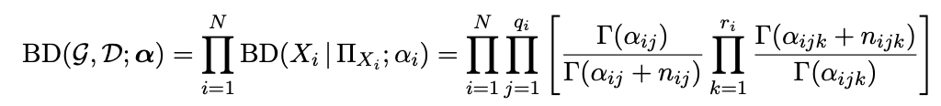
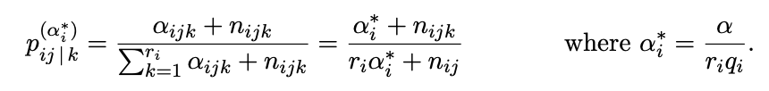
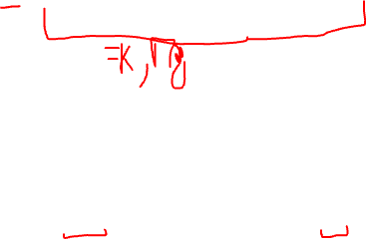
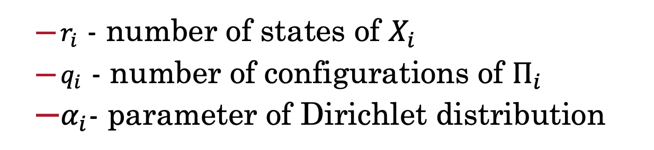
Parameter Estimation. Bayesian Approach
Bayesian Dirichlet Score:
$r_{i}$ - number of states of $X_{i}$
$q_{i}$ - number of configurations of $Π_{i}$
$α_{i}$- parameter of Dirichlet distribution
Bayesian Dirichlet Equivalent Uniform Score:
Notes:
The Bayesian Parameter Estimator starts with already existing prior CPDs, that express our beliefs about the variables *before* the data was observed. Those "priors" are then updated, using the state counts from the observed data. See [1], Section 17.3 for a general introduction to Bayesian estimators.
One can think of the priors as consisting in *pseudo state counts*, that are added to the actual counts before normalization.
Unless one wants to encode specific beliefs about the distributions of the variables, one commonly chooses uniform priors, i.e. ones that deem all states equiprobable.
A very simple prior is the so-called *K2* prior, which simply adds `1` to the count of every single state.
A somewhat more sensible choice of prior is *BDeu* (Bayesian Dirichlet equivalent uniform prior). For BDeu we need to specify an *equivalent sample size* `N` and then the pseudo-counts are the equivalent of having observed `N` uniform samples of each variable (and each parent configuration). In pgmpy:

Slide 8
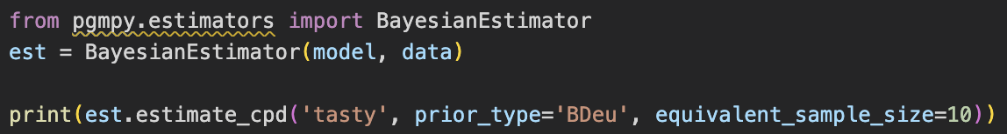
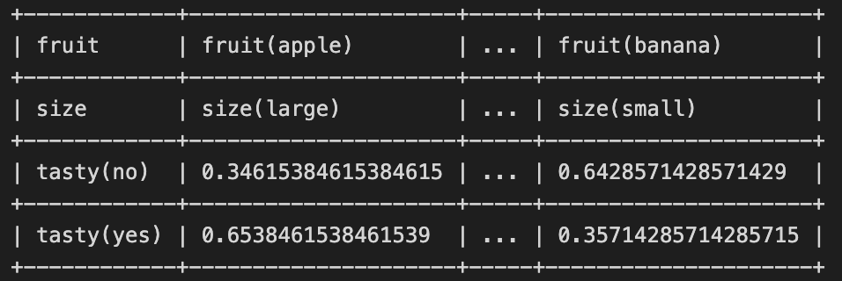

Parameter Estimation. Bayesian
Fruit
Size
Tasty
Notes:
The estimated values in the CPDs are now more conservative. In particular, the estimate for a small banana being not tasty is now around `0.64` rather than `1.0`. Setting `equivalent_sample_size` to `10` means that for each parent configuration, we add the equivalent of 10 uniform samples (here: `+5` small bananas that are tasty and `+5` that aren't).
`BayesianEstimator`, too, can be used via the `fit()`-method. Full example:

Slide 9
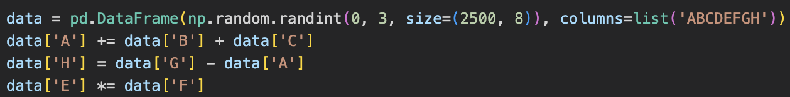
Structure Learning. New Network
B
C
A
G
E
H
F

Slide 10
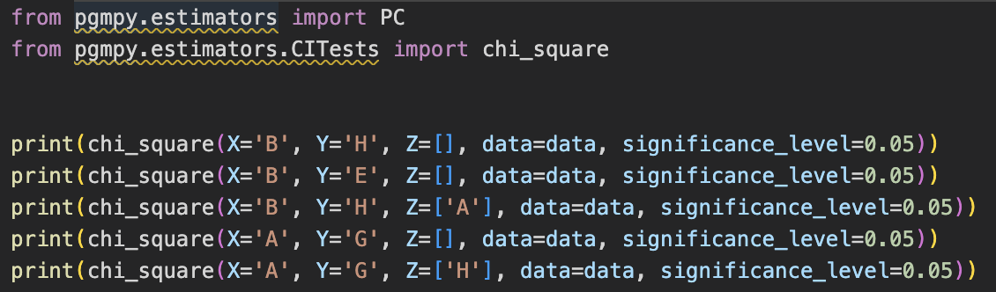
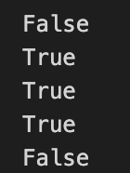
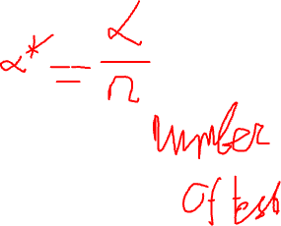
Structure Learning. Constraints
B
C
A
G
E
H
F
Notes:
Multiple testing

Slide 11
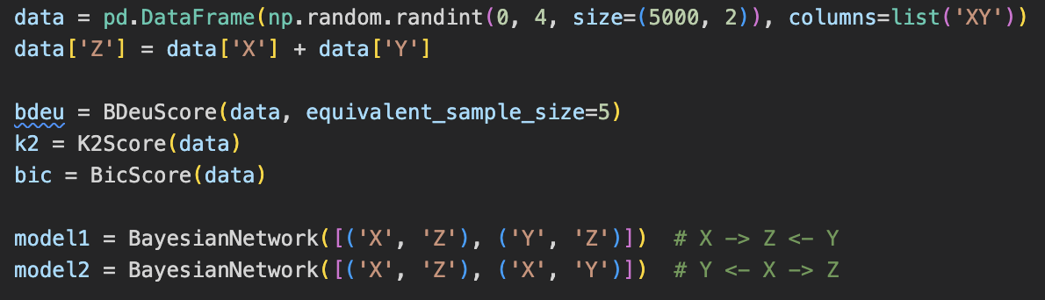
Structure Learning. Scoring
X
Y
X
Y
Z
Z
Notes:
This approach construes model selection as an optimization task. It has two building blocks:
- A _scoring function_ $s_D\colon M \to \mathbb R$ that maps models to a numerical score, based on how well they fit to a given data set $D$.
- A _search strategy_ to traverse the search space of possible models $M$ and select a model with optimal score.
#### Scoring functions
Commonly used scores to measure the fit between model and data are _Bayesian Dirichlet scores_ such as *BDeu* or *K2* and the _Bayesian Information Criterion_ (BIC, also called MDL). See [1], Section 18.3 for a detailed introduction on scores. As before, BDeu is dependent on an equivalent sample size.

Slide 12
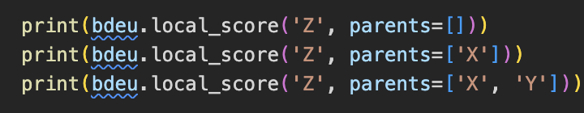
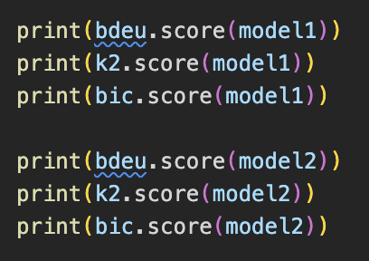
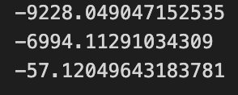
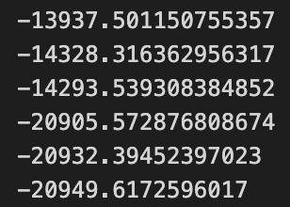

Structure Learning. Scoring
X
Y
X
Y
Z
Z
Notes:
While the scores vary slightly, we can see that the correct `model1` has a much higher score than `model2`.
Importantly, these scores _decompose_, i.e. they can be computed locally for each of the variables given their potential parents, independent of other parts of the network:

Slide 13
Structure Learning. Scoring
X
Y
X
Y
Z
Z
Notes:
While the scores vary slightly, we can see that the correct `model1` has a much higher score than `model2`.
Importantly, these scores _decompose_, i.e. they can be computed locally for each of the variables given their potential parents, independent of other parts of the network:

Slide 14
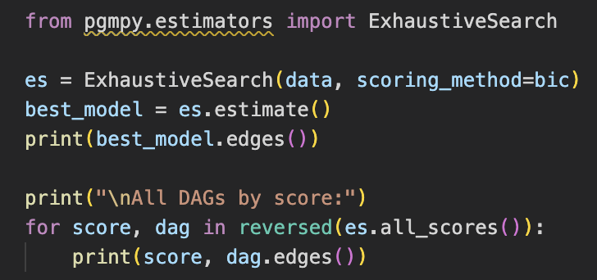
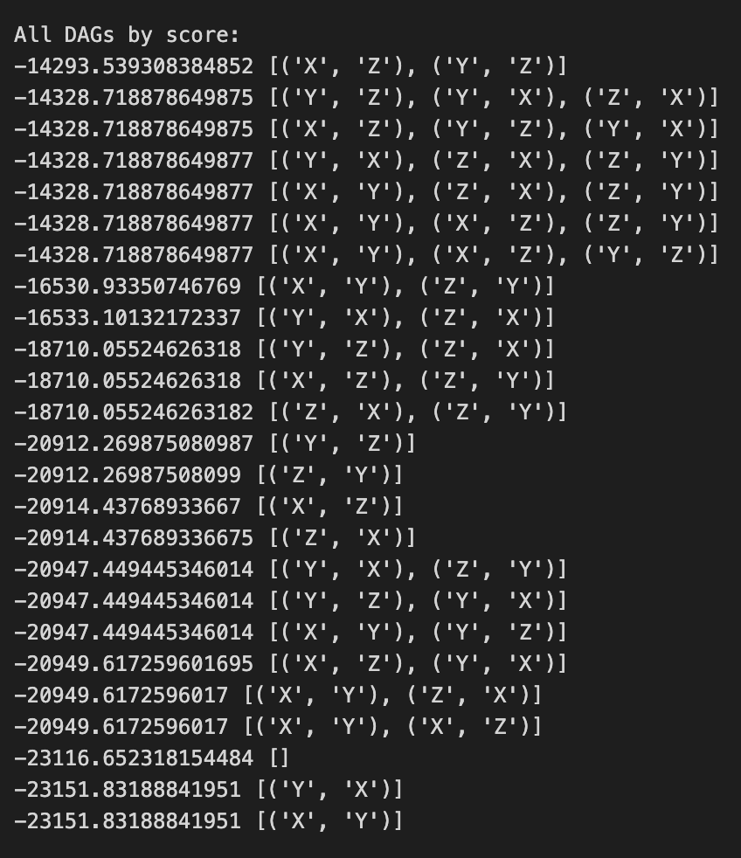

Structure Learning. Search
X
Y
Z
Notes:
#### Search strategies
The search space of DAGs is super-exponential in the number of variables and the above scoring functions allow for local maxima. The first property makes exhaustive search intractable for all but very small networks, the second prohibits efficient local optimization algorithms to always find the optimal structure. Thus, identifiying the ideal structure is often not tractable. Despite these bad news, heuristic search strategies often yields good results.
If only few nodes are involved (read: less than 5), `ExhaustiveSearch` can be used to compute the score for every DAG and returns the best-scoring one:

Slide 15
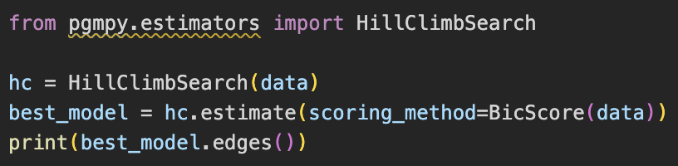
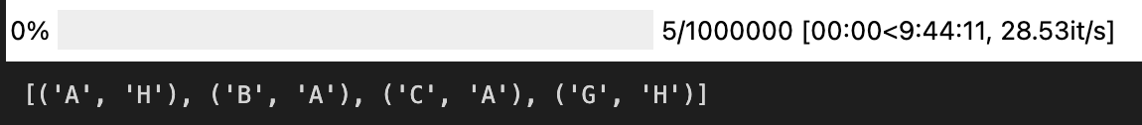
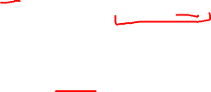
Structure Learning. Search
B
C
A
G
H
Notes:
The search correctly identifies e.g. that `B` and `C` do not influnce `H` directly, only through `A` and of course that `D`, `E`, `F` are independent.
To enforce a wider exploration of the search space, the search can be enhanced with a tabu list. The list keeps track of the last `n` modfications; those are then not allowed to be reversed, regardless of the score. Additionally a `white_list` or `black_list` can be supplied to restrict the search to a particular subset or to exclude certain edges. The parameter `max_indegree` allows to restrict the maximum number of parents for each node.

Slide 16
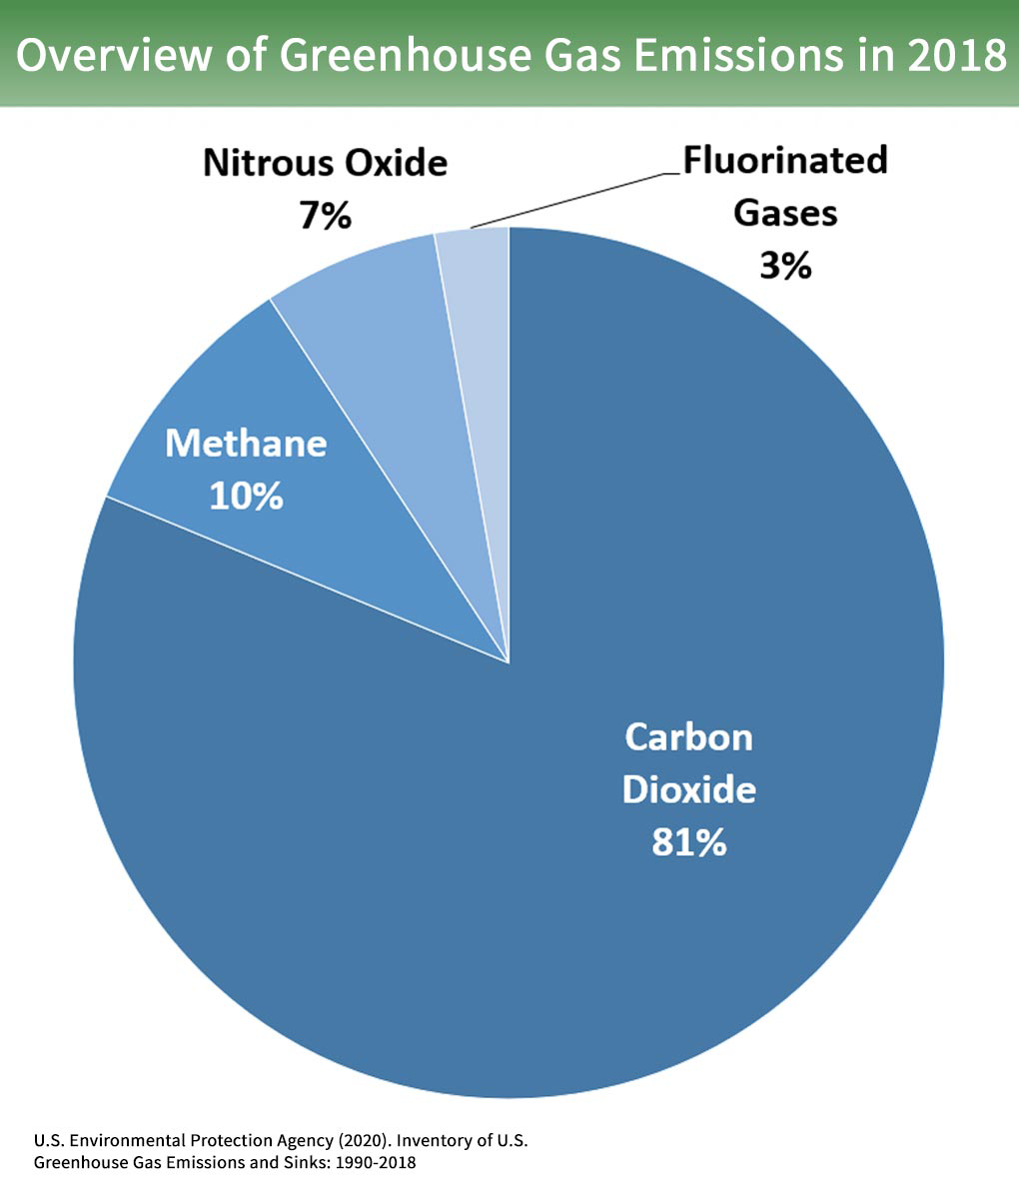
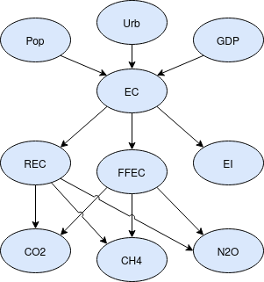
Practical Problem
Notes:
Nowadays it is well established that **global warming** is hugely caused by greenhouse gases, which are indeed responsible for trapping heat in the atmosphere. The 3 most common gases are carbon dioxide (**CO**<sub><b>2</b></sub>), methane (**CH**<sub><b>4</b></sub>) and nitrous oxide (**N**<sub><b>2</b></sub>**O**) [[1]](#first).
There are several sources of greenhouse gases, such as transportation, industry, commercial and residental. In this document I will tackle the problem in a general way, considering the impact of energy consumption on greenhouse gases emissions. Energy is indeed strictly related to almost all source factors. In particular, I will face the modelling of **causal relations** between **energy consumption and greenhouse gases in Italy** using a **Bayesian network**. The aim is to learn a model that can provide **probabilistic results given** some input **evidence**. The causal relations and their relative probabilities will be estimated by analyzing **annual growth factors** of several indicators from open source datasets of the World Bank Group (WBG) [[3]](#third). The choice of analyzing the annual growth aims to capture how the variation of an indicator can affect the others.
This work starts from a paper by Cinar and Kayakutlu (2010) [[2]](#second) in which the authors produced estimates about energy investments in Turkey given historical data. Their work helped me to come up with interesting measures to be investigated and to be represented in the Bayesian network. I could extend their work adding: a more comprehensive analysis of network properties (**conditional independencies, active trails, Markov blankets**), concise and effective high level functions (such as `query_report`, `check_assertion` and `active_trails_of`) to express the most significant properties in a readable format and the whole code **to learn the Bayesian network** from the available datasets.

Slide 17
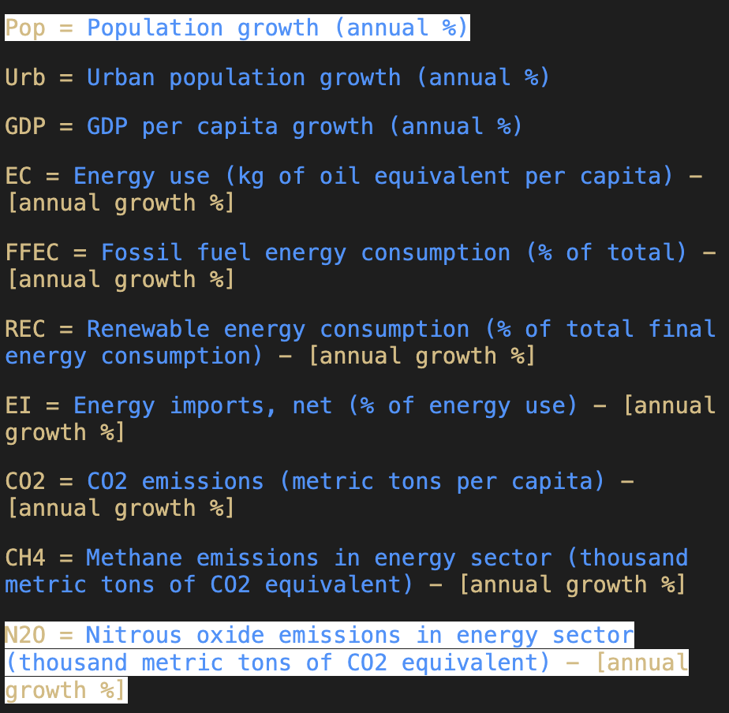
Practical Problem
Notes:
Nowadays it is well established that **global warming** is hugely caused by greenhouse gases, which are indeed responsible for trapping heat in the atmosphere. The 3 most common gases are carbon dioxide (**CO**<sub><b>2</b></sub>), methane (**CH**<sub><b>4</b></sub>) and nitrous oxide (**N**<sub><b>2</b></sub>**O**) [[1]](#first).
There are several sources of greenhouse gases, such as transportation, industry, commercial and residental. In this document I will tackle the problem in a general way, considering the impact of energy consumption on greenhouse gases emissions. Energy is indeed strictly related to almost all source factors. In particular, I will face the modelling of **causal relations** between **energy consumption and greenhouse gases in Italy** using a **Bayesian network**. The aim is to learn a model that can provide **probabilistic results given** some input **evidence**. The causal relations and their relative probabilities will be estimated by analyzing **annual growth factors** of several indicators from open source datasets of the World Bank Group (WBG) [[3]](#third). The choice of analyzing the annual growth aims to capture how the variation of an indicator can affect the others.
This work starts from a paper by Cinar and Kayakutlu (2010) [[2]](#second) in which the authors produced estimates about energy investments in Turkey given historical data. Their work helped me to come up with interesting measures to be investigated and to be represented in the Bayesian network. I could extend their work adding: a more comprehensive analysis of network properties (**conditional independencies, active trails, Markov blankets**), concise and effective high level functions (such as `query_report`, `check_assertion` and `active_trails_of`) to express the most significant properties in a readable format and the whole code **to learn the Bayesian network** from the available datasets.

Slide 18
Practical Problem
Notes:
Nowadays it is well established that **global warming** is hugely caused by greenhouse gases, which are indeed responsible for trapping heat in the atmosphere. The 3 most common gases are carbon dioxide (**CO**<sub><b>2</b></sub>), methane (**CH**<sub><b>4</b></sub>) and nitrous oxide (**N**<sub><b>2</b></sub>**O**) [[1]](#first).
There are several sources of greenhouse gases, such as transportation, industry, commercial and residental. In this document I will tackle the problem in a general way, considering the impact of energy consumption on greenhouse gases emissions. Energy is indeed strictly related to almost all source factors. In particular, I will face the modelling of **causal relations** between **energy consumption and greenhouse gases in Italy** using a **Bayesian network**. The aim is to learn a model that can provide **probabilistic results given** some input **evidence**. The causal relations and their relative probabilities will be estimated by analyzing **annual growth factors** of several indicators from open source datasets of the World Bank Group (WBG) [[3]](#third). The choice of analyzing the annual growth aims to capture how the variation of an indicator can affect the others.
This work starts from a paper by Cinar and Kayakutlu (2010) [[2]](#second) in which the authors produced estimates about energy investments in Turkey given historical data. Their work helped me to come up with interesting measures to be investigated and to be represented in the Bayesian network. I could extend their work adding: a more comprehensive analysis of network properties (**conditional independencies, active trails, Markov blankets**), concise and effective high level functions (such as `query_report`, `check_assertion` and `active_trails_of`) to express the most significant properties in a readable format and the whole code **to learn the Bayesian network** from the available datasets.

Slide 19
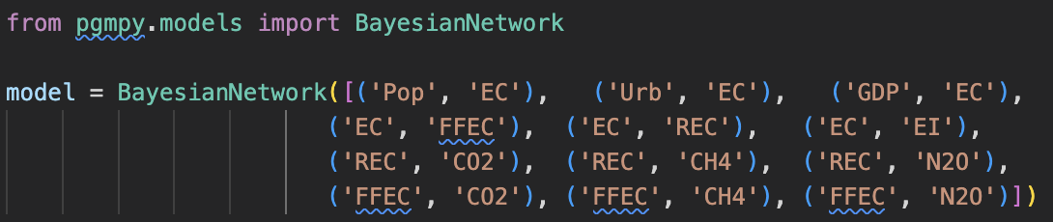
Practical Problem
PGMpy does not support learning from continuous variables!
Notes:
### Datasets
The **data** to compute the conditional probability tables (CPT) of the network are retrived from [[3]](#third). Some data are given there in absolute values and not in terms of **annual growth**, hence it is necessary to transform them properly (the labels of transformed data are marked with the trailing string "*- [annual growth %]*").
A good methodology to organize **historical data to infer CPT**, as shown also in [[2]](#second), is to **group** them **by year**, such that historical values of the same year are treated as a single tuple and thus they constitute a whole entry of the dataset. **Data discretization** is also needed, [since pgmpy does not support learning from continuous variables](https://github.com/pgmpy/pgmpy/issues/1084), and so all values are mapped into 3 fixed tiers. In order to minimize data sparsity, the boundaries of the mapping intervals are chosen such that each tier of the same node contains an equal number of samples.
The pgmpy learning algorithms expect as input a dataframe in which each entry represents an *observed event* — a year in this case. As a consequence some **data preprocessing** is needed to make the raw data compatible with the required signature. It is worth noting that pgmpy handles learning task with **sparse datasets** (i.e. [it handles NaN values](https://pgmpy.org/estimators.html)). To compute indeed the CPT for a given node in the network there are used only those entries in which both the node itself and its parents are defined (i.e. an entry is used to compute a given CPT only if all needed values of that year are defined). This fact implies that the deeper the network is, the less sparse the dataset should be to compute significant CPT.
As a side note, mind the fact that industrialization growth, which is expressed by indicators such as [industry value added](https://data.worldbank.org/indicator/NV.IND.TOTL.KD.ZG?locations=IT&view=chart), is not represented in the newtork. Data regarding industrialization are available only for a short year range in [[3]](#third) and the industrialization node would be on top of the network hierarchy, being a parent of the node 'EC'. As a consequence, if industrialization would be represented, then the overall learning process could rely only on a small subset of all the available data and the network parameters would be estimated less significantly.
In the following cells data are imported and preprocessed.

Slide 20
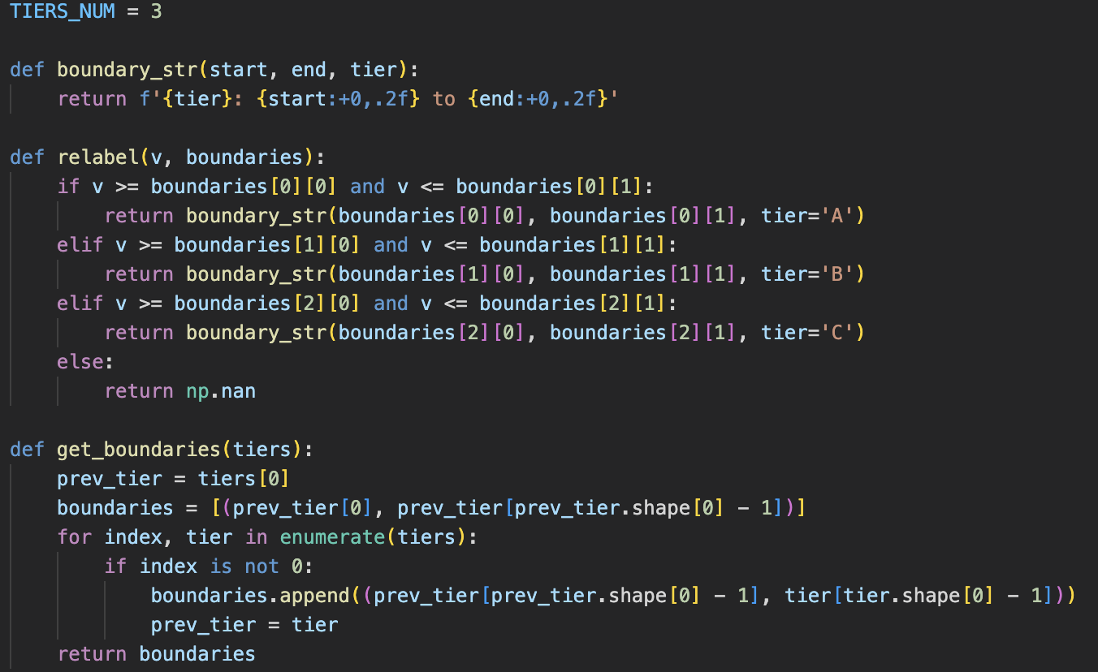
Data Discretization
Notes:
### Datasets
The **data** to compute the conditional probability tables (CPT) of the network are retrived from [[3]](#third). Some data are given there in absolute values and not in terms of **annual growth**, hence it is necessary to transform them properly (the labels of transformed data are marked with the trailing string "*- [annual growth %]*").
A good methodology to organize **historical data to infer CPT**, as shown also in [[2]](#second), is to **group** them **by year**, such that historical values of the same year are treated as a single tuple and thus they constitute a whole entry of the dataset. **Data discretization** is also needed, [since pgmpy does not support learning from continuous variables](https://github.com/pgmpy/pgmpy/issues/1084), and so all values are mapped into 3 fixed tiers. In order to minimize data sparsity, the boundaries of the mapping intervals are chosen such that each tier of the same node contains an equal number of samples.
The pgmpy learning algorithms expect as input a dataframe in which each entry represents an *observed event* — a year in this case. As a consequence some **data preprocessing** is needed to make the raw data compatible with the required signature. It is worth noting that pgmpy handles learning task with **sparse datasets** (i.e. [it handles NaN values](https://pgmpy.org/estimators.html)). To compute indeed the CPT for a given node in the network there are used only those entries in which both the node itself and its parents are defined (i.e. an entry is used to compute a given CPT only if all needed values of that year are defined). This fact implies that the deeper the network is, the less sparse the dataset should be to compute significant CPT.
As a side note, mind the fact that industrialization growth, which is expressed by indicators such as [industry value added](https://data.worldbank.org/indicator/NV.IND.TOTL.KD.ZG?locations=IT&view=chart), is not represented in the newtork. Data regarding industrialization are available only for a short year range in [[3]](#third) and the industrialization node would be on top of the network hierarchy, being a parent of the node 'EC'. As a consequence, if industrialization would be represented, then the overall learning process could rely only on a small subset of all the available data and the network parameters would be estimated less significantly.
In the following cells data are imported and preprocessed.

Slide 21
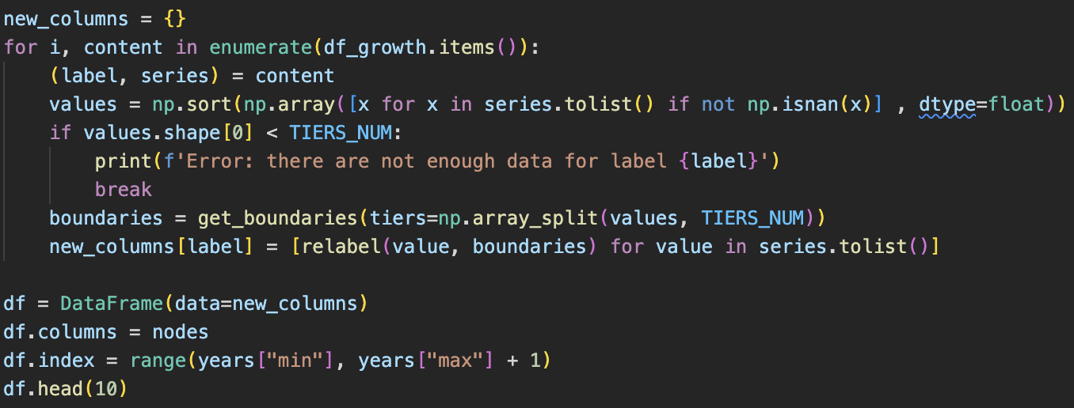
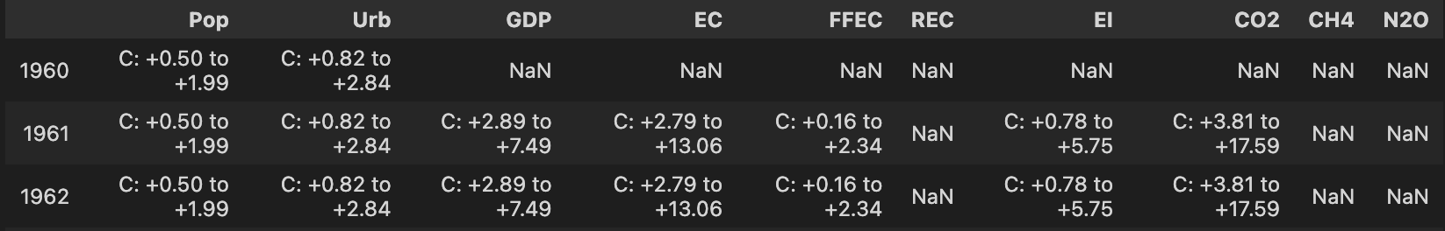
Data Discretization

Slide 22
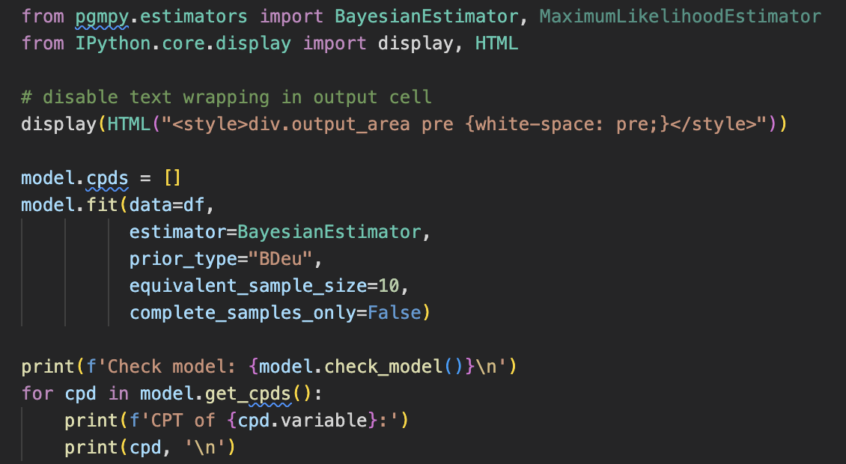
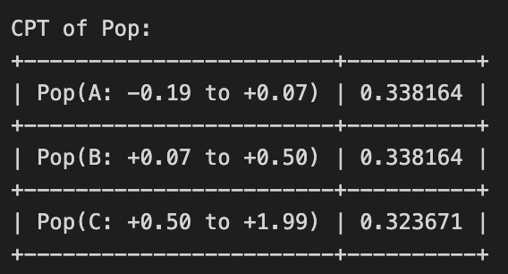
Learning Parameters
Notes:
In pgmpy it is possible to learn the CPT of a given Bayesian network using either a **Bayesian Estimator** or a **Maximum Likelihood Estimator** (MLE). The former exploits a known prior distribution of data, the latter does not make any particular assumption.
**MLE can overfit** the data in case of **small datasets**, because there can be not enough observations and thus the observed frequencies can be not representative. Another problem with MLE is the fact that **state counts** are done **conditionally** for each **parents configuration** and this causes immense fragmentation since the state counts drop even more. The **Bayesian estimator** instead does not only rely on input data to learn the network parameters, but it also takes advantage of a **prior knowledge**, expressed through a prior distribution. In this way, the estimator does not have an absolute guide, but rather a reasonable **starting assumption** that allows to counterbalance the lack of data.
Although the MLE approach seems plausible, it can be overly simplistic in many cases, whereas the Bayesian one is intrinsically more robust. As a consequence the **Bayesian estimator is choosen**.
There are several prior distribuitions available in pgmpy, a sensible choice of **prior** is the **Bayesian Dirichlet equivalent uniform prior** (BDeu). In the learning process, using BDeu, **N uniform samples** are **generated** for each variable to compute the pseudo-counts (default is N=5), hence the estimated probabilities in CPT are more conservative than the ones obtained through MLE (i.e. probabilities close to 1 or 0 get smoothed).
In the following cell the CPT are learned and displayed.

Slide 23
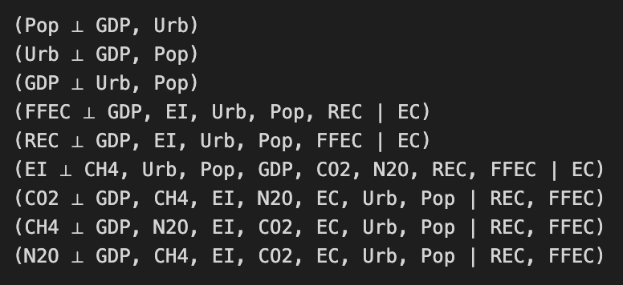
Analyzing Network
Notes:
In pgmpy it is possible to learn the CPT of a given Bayesian network using either a **Bayesian Estimator** or a **Maximum Likelihood Estimator** (MLE). The former exploits a known prior distribution of data, the latter does not make any particular assumption.
**MLE can overfit** the data in case of **small datasets**, because there can be not enough observations and thus the observed frequencies can be not representative. Another problem with MLE is the fact that **state counts** are done **conditionally** for each **parents configuration** and this causes immense fragmentation since the state counts drop even more. The **Bayesian estimator** instead does not only rely on input data to learn the network parameters, but it also takes advantage of a **prior knowledge**, expressed through a prior distribution. In this way, the estimator does not have an absolute guide, but rather a reasonable **starting assumption** that allows to counterbalance the lack of data.
Although the MLE approach seems plausible, it can be overly simplistic in many cases, whereas the Bayesian one is intrinsically more robust. As a consequence the **Bayesian estimator is choosen**.
There are several prior distribuitions available in pgmpy, a sensible choice of **prior** is the **Bayesian Dirichlet equivalent uniform prior** (BDeu). In the learning process, using BDeu, **N uniform samples** are **generated** for each variable to compute the pseudo-counts (default is N=5), hence the estimated probabilities in CPT are more conservative than the ones obtained through MLE (i.e. probabilities close to 1 or 0 get smoothed).
In the following cell the CPT are learned and displayed.

Slide 24
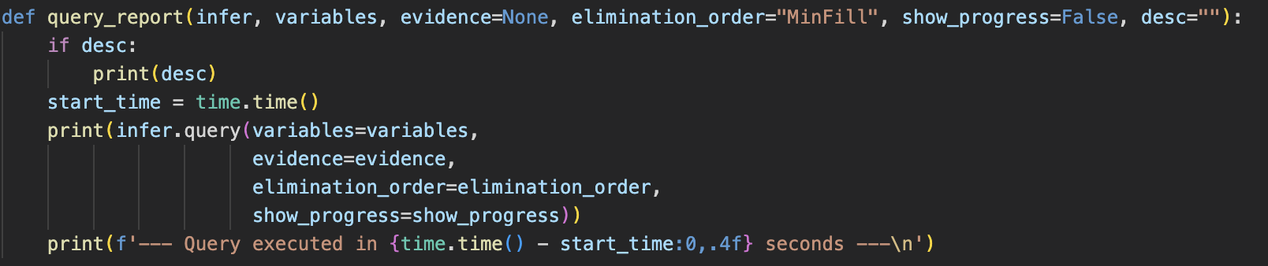
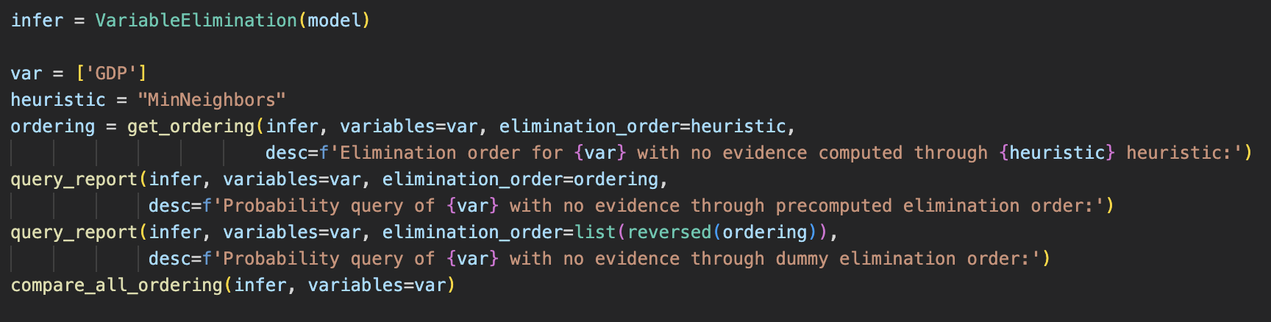
Querying Network
Notes:
In pgmpy it is possible to perform **inference** on a Bayesian network through the **Variable Elimination method**. The **elimination order** is evaluated through **heuristic functions**, which assign an elimination cost to each node that has to be removed (i.e. to each node apart from the query nodes and the evidence nodes). The variable elimination algorithm is then executed accordingly with the assigned node costs.
The [available heuristic functions](https://pgmpy.org/inference.html#module-pgmpy.inference.EliminationOrder) assign the cost of a node as:
- `MinFill`: the number of edges that need to be added to the graph due to its elimination.
- `MinNeighbors`: the number of neighbors it has in the current graph.
- `MinWeight`: the product of weights, domain cardinality, of its neighbors.
- `WeightedMinFill`: the sum of weights of the edges that need to be added to the graph due to its elimination, where a weight of an edge is the product of the weights, domain cardinality, of its constituent vertices.
The following cell is dedicated to inference queries and experiments on the cost heuristic functions.

Slide 25
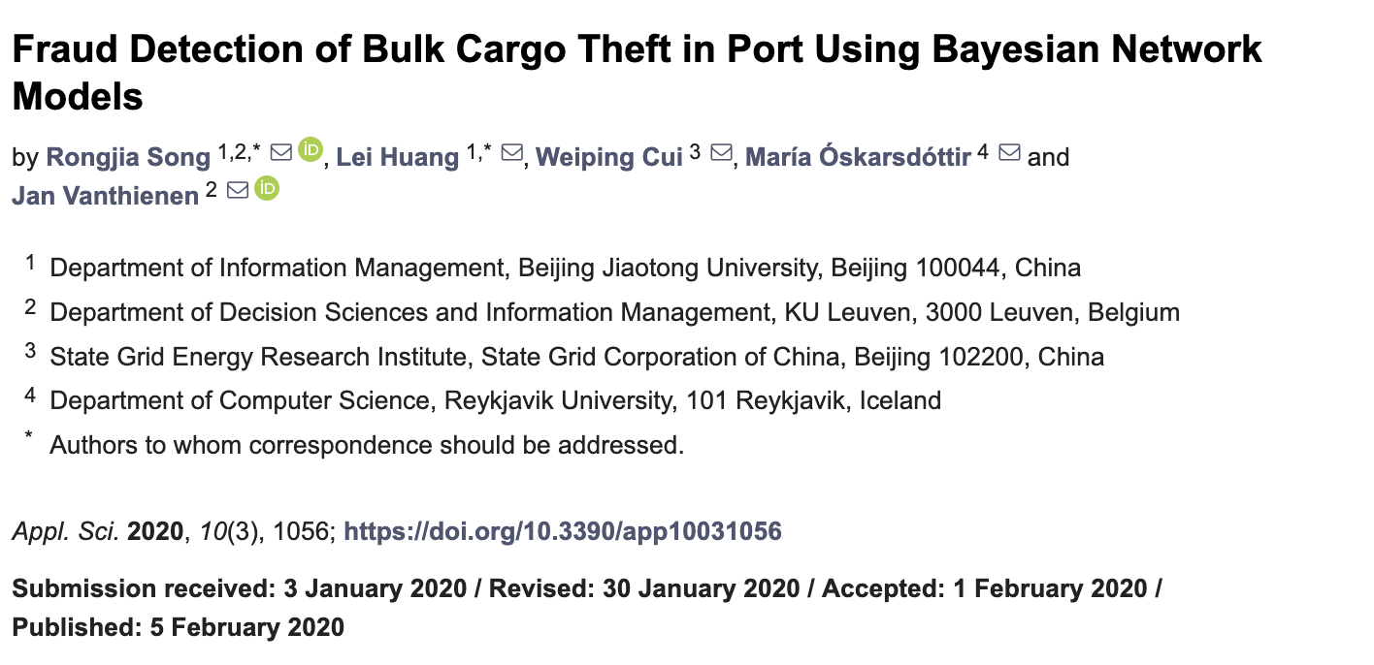
Fraud Detection of Bulk Cargo Theft in Port

Slide 26
Fraud Detection of Bulk Cargo Theft in Port
ID | Event Description
1 | On the night of 14 March 2014, driver Zhou drove the truck with plate number XiangX. He stole 3.88 tons of brown coal (Indonesia coal, Lower Heating Value: 4400 Kcal/Kg) from terminal A of Guangzhou Port by reforming or retrofitting the water tank of the truck. The truck came into the terminal A with water in the tank and released the water before loading. Then he secretly transported the stolen cargo, identified to have a value of 455 yuan per ton and 1765.4 yuan in total, to the factory B in DongGuan.
2 | On the night of 11 April 2014, driver Cao drove the truck with plate number YueY, and stole 3.89 tons of coal (Indonesian Steam Coal, Lower Heating Value: 4651 Kcal/Kg) from terminal C of Guangzhou Port by reforming the car hopper of the truck. The truck came into the terminal C with objects in the car hopper and that were released before loading. Then he secretly transported this cargo from the theft, identified to have a value of 518 yuan per ton and 2011.3 yuan in total, to the factory D in DongGuan.
Song, Rongjia, et al. "Fraud detection of bulk cargo theft in port using bayesian network models." Applied Sciences 10.3 (2020): 1056

Slide 27
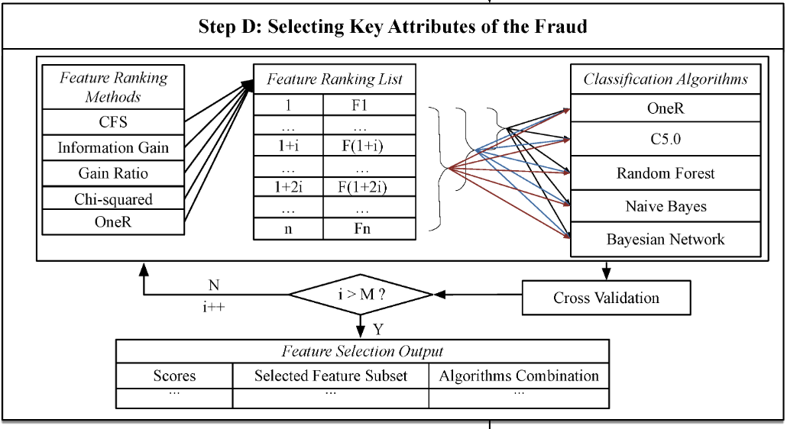
Fraud Detection of Bulk Cargo Theft in Port

Slide 28
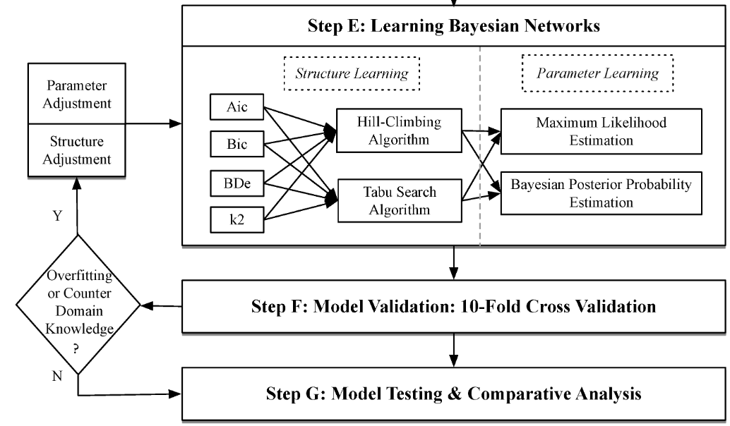
Fraud Detection of Bulk Cargo Theft in Port

Slide 29
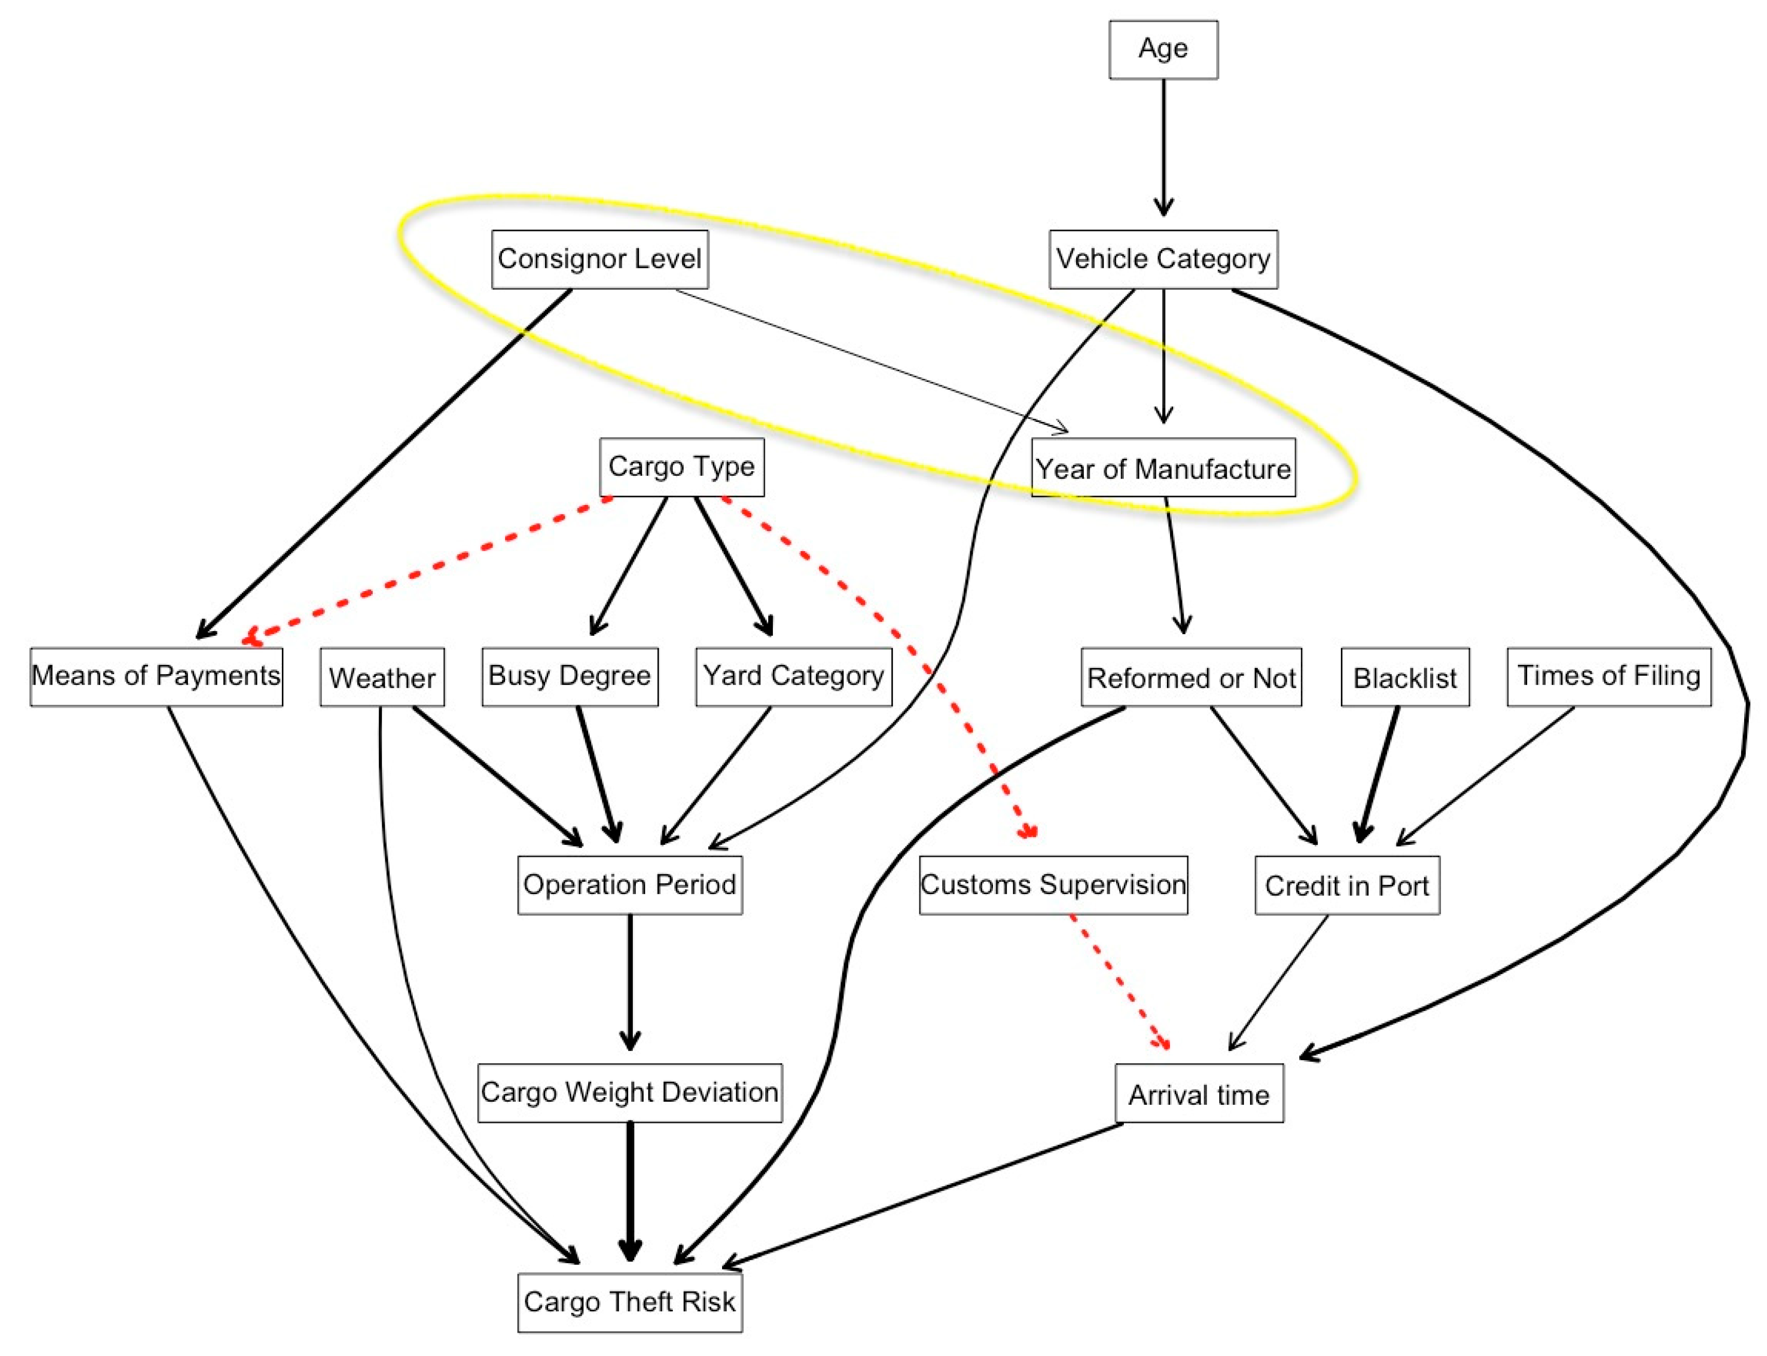
Fraud Detection of Bulk Cargo Theft in Port
Tabu search results

Slide 30
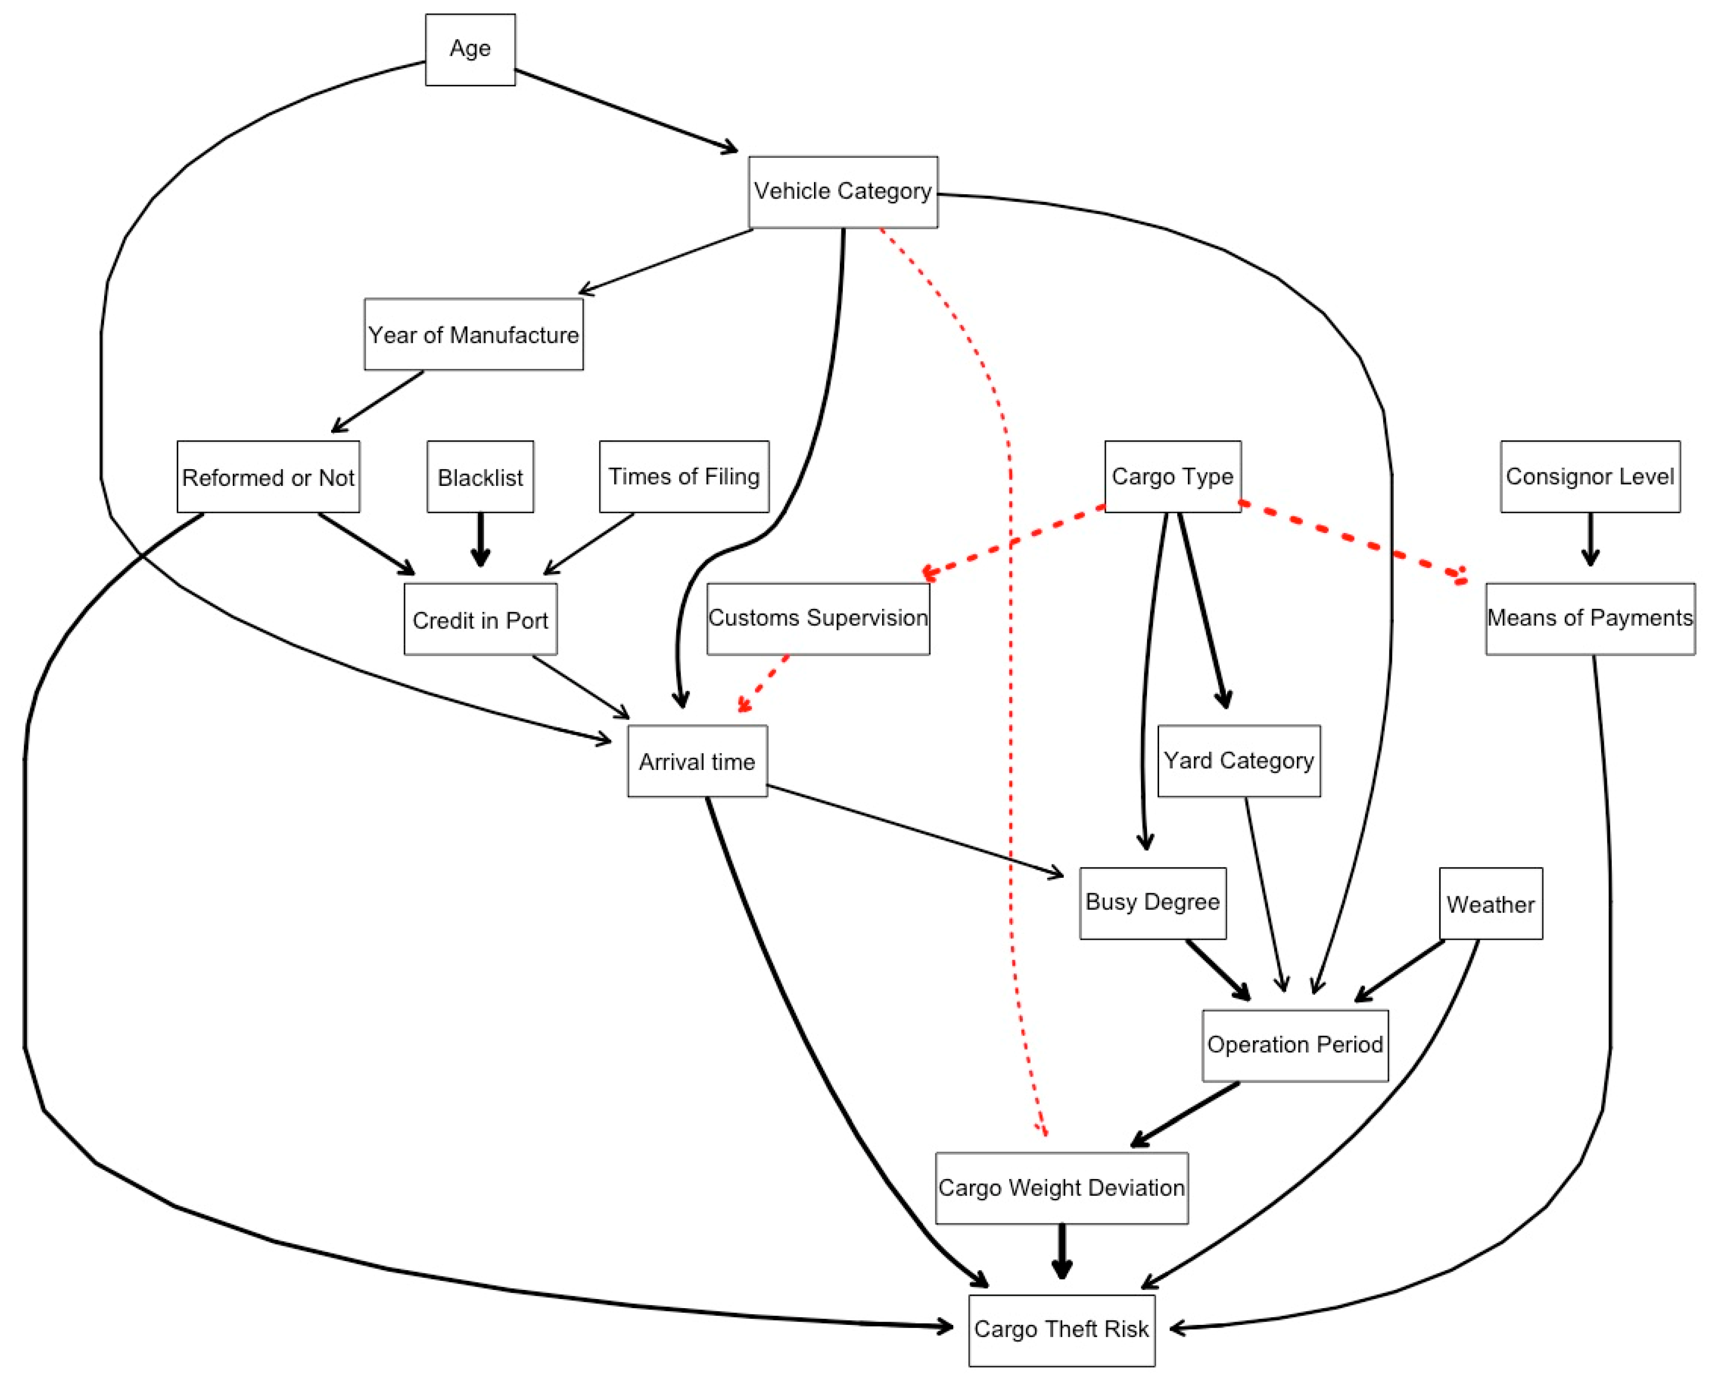
Fraud Detection of Bulk Cargo Theft in Port
Hill Climb algorithm results

